Slide 1
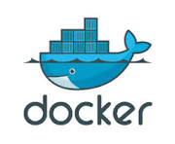

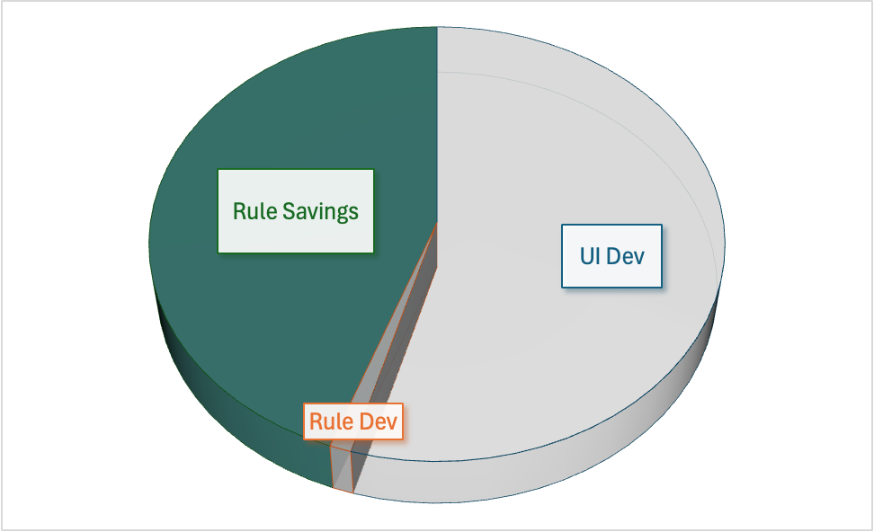

LOB Parallel
Export
Dev Friendly
- Your IDE
- No FrankenCode
- Standard Client App Dev
-- Unblocked by API Dev
-- API Factors out logic
-- Use: Dev/AI, Low-Code, Framework
Solid Requirements
Export
API/Logic Automation
- Solid Architecture
- Rules Decrease Effort 50%
GenAI: Kickstart
- Idea to Run: 1 Minute
- Zero Training
- DB, API, Default App
Notes:
This illustrates how a GenAI-based Kickoff enables anyone to convert an idea to a running system, and later, as required, hand over a system to developers they can complete using the tools with which they are familiar. This is often a challenge for many Low Code Systems that can be very dev-unfriendly. This can introduce organization stress between Line of Business and Dev.
In fact, the use of declarative rules enables not only a graceful turn-over to Dev, but an entirely new capability: Multi-Team Development. As shown by the diverging branches, the LOB users can continue to develop their idea in parallel, and integrate these into the dev branch.
This integration is not a manual code merge, a frightfully difficult process. Instead, the software - not manual effort - automates the integration. It works like this:
The project begins with the Kickstart: several iterations to get solid requirements.
Uses Natural Language and Declarative Rules
The project is exported: the Dev Team begin work on the Custom UI, Enterprise Integration, etc
This is not the end of declarative: logic is either or both of Natural Language, and Python DSL
As depicted in the divergent arcs: there are now 2 versions of the project. Both can, in parallel, introduce new rules and attributes. This is not just "Team Development", it is TeamS Development.
LOB Parallel: (WG_Team): new rules & attributes
Observe: WG is not a day-1-only pilot...
They continue to use the Natural Language Web-Based interface (WebGenai)
Dev_Team: their own new rules & attributes, using either genai Natural Language and/or alembic...
In addition, the server team also uses Python (and) and libs as required, e.g. for enterprise integration.
They do this in their favorite IDE, with tools such as GitHub etc.
Observe the logic remains at a high lev
The UI team can use familiar tools for Custom UIs. These
leverage the API (ready day 1, so they are not blocked on API Dev), and
are dramatically simplified by automated backend rule-based logic
Export 2: illustrates that the LOB WG_Team can export their project. The dev team can import it using the API Logic Server CLI.
This automatically integrates rules and attributes from both projects, updating the dev project with a new database and models.
This is virtually impossible with procedural code, because developers must manually assess the execution dependencies and order the logic properly. It time-consuming, complex, and error-prone - just like post deployment maintenance.
The integration is automatic and "safe" because logic is expressed in a declarative rules/models for which ordering is automatic.
It also rebuilds the test data, per your rules (e.g. sum/count values)
The process supports multiple exports.

Slide 2
Logic
Backend Half of System
40X More Concise
Notes:
Rule Savings
For typical database systems providing updates, the backend is nearly half the effort. Rules reduce logic by a factor of 40: https://apilogicserver.github.io/Docs/Logic-Why/#problem-code-explosion
Admin Apps
Admin (back office) Apps are 15% of the UI effort
They are completely automated.
For Custom UI Dev, use standard approaches: AI Dev, Low Code, Frameworks such as Ontimize

Slide 3
Kickstart
From: Natural Language
No Database Definition
No Screen Painting
Creates: Project for Your IDE
Models, Not FrankenCode
Declarative Logic and Security
Idea to Running: 1 Minute

Slide 4
Models, Not FrankenCode
Created Project
Models
(+ code as required)
Runtime Libs
Execution
Engines
App
safrs/ra
Customers
Orders
Products
Items
GenAI-Logic
API
safrs
Database
SQLAlchemy
Rules
LogicBank
Notes:
Project Creation results in models, not code.
The models are executed by corresponding runtime engines.
Provide standard Python code (e.g., events) as required.

Slide 5
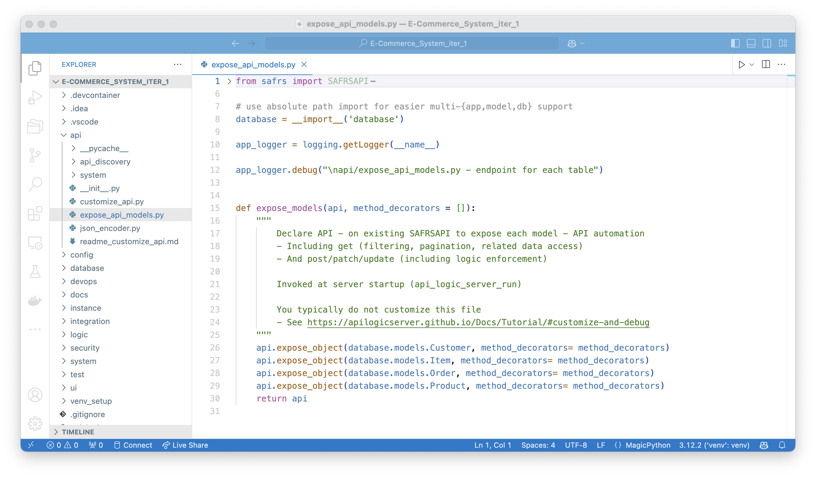
Project Created by
GenAI/Logic Automation
Model Driven
API is 4 lines of code
Simple and Clear
Not FrankenCode
Notes:
We are not claiming, by any means, that GenAI can automate complete Enterprise-class systems. You will want custom front ends, integration with business partners and internal systems, etc. This means developers absolutely need to get involved.
With… what? All we’ve provided is a few prompts…
As you might have expected, a project has been created. It’s a standard Python project you can download and extend in your favorite IDE, completely configured and ready to run.
Developers are cautious about generated “Franken-code”, for good reason. It can be monstrously difficult to understand, debug and extend.
So, GenAI-Logic creates models, not code.
The API is shown above.

Slide 6
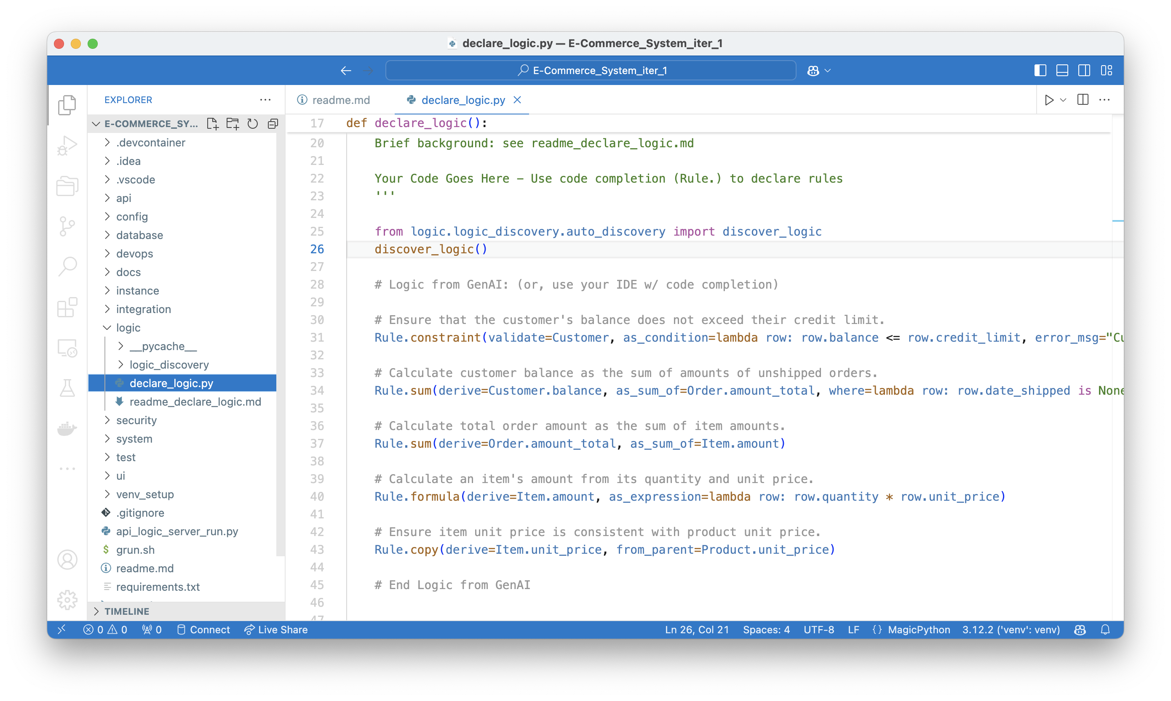
Logic
Backend Half of System
40X More Concise
Similar Support
For Row Based
Access Control
Notes:
And here is the logic - 5 Python statements. It’s still at the same high level of abstraction, but you can now use code editors, debuggers and source control:
Note the automation process did not just generate “raw” Python code. It would be around 200 lines. And we tried it: basic GenAI creates code that is poorly optimized, and wrong (e.g., it missed the “reselect Product” corner case above). FrankenCode, at it’s worst.
The ideal approach marries GenAI with Logic Automation for UI, APIs and Logic… just like it does for SQL.

Slide 7
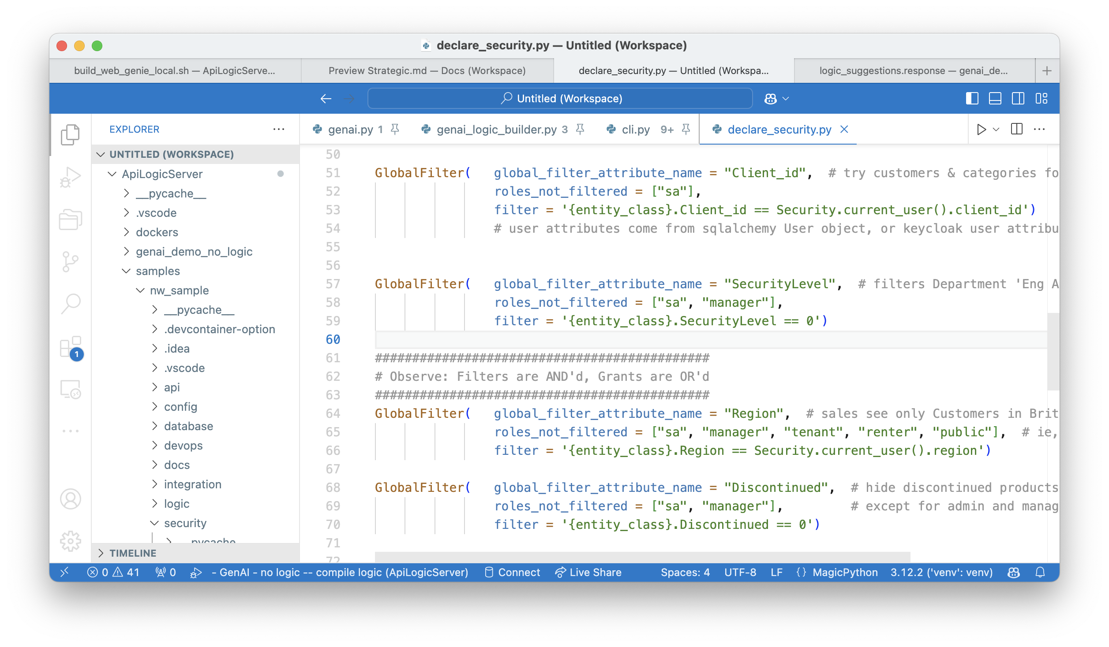
Declare Security
Authenticate (e.g., Keycloak)
Authorize (Role Based Access Control to Rows)
Notes:
Declarative support includes Security:
Authentication: use a database table, or Keycloak – Single SignOn, open authenticator (gmail, LDAP, AD, etc)
Authorization: configure roles with row level filters (eg, discontinued products, multi-tenant).

Slide 8
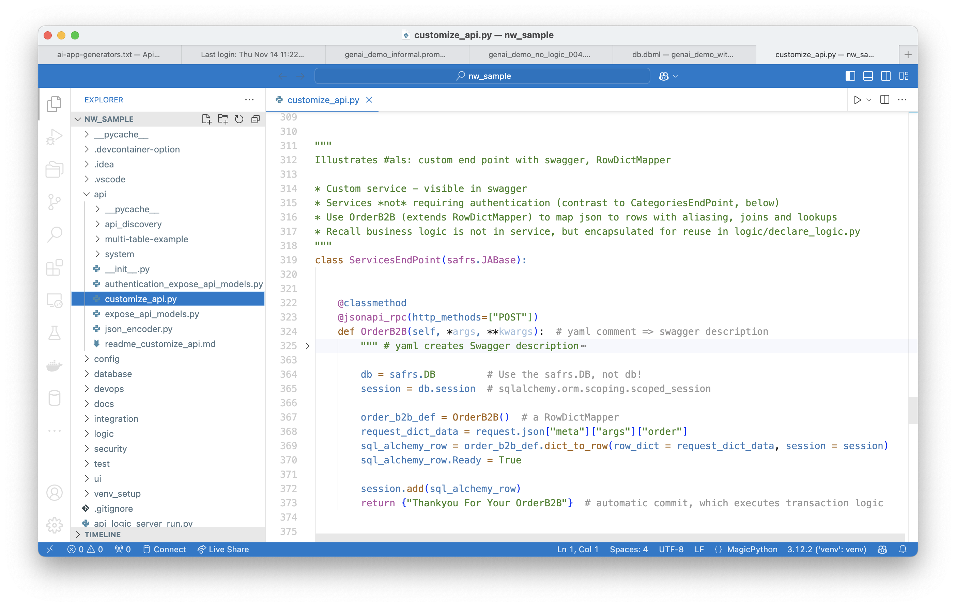
Custom API
Minimal Code,
since API enforces logic (via SQLAlchemy events)
Notes:
And, you have access to all the underlying standard tools (your IDE, GitHub etc) and frameworks. You can add custom endpoints, e.g., APIs for B2B partners, as shown here.

Slide 9
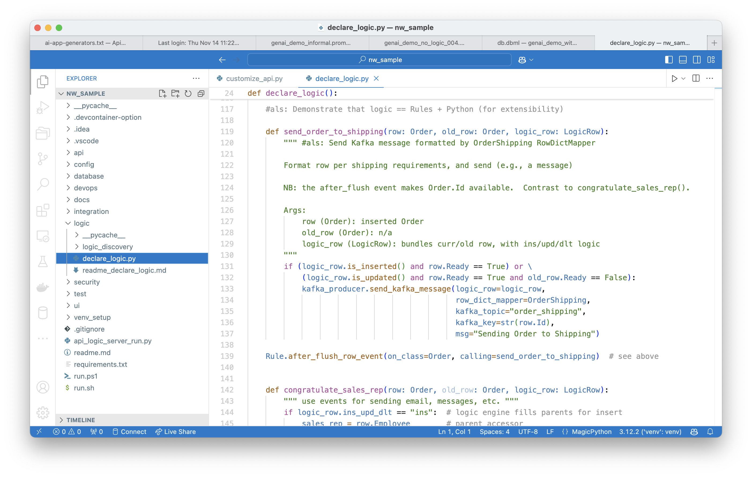
App Integration
Extend Logic with Kafka Integration
Notes:
Add logic to send messages, as shown here.
Organizational Velocity, Enterprise scale

Slide 10
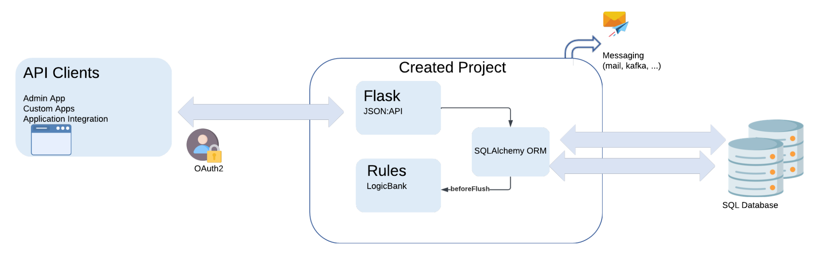
API Logic Server - Runtime Stack
API Encapsulates Rules
Notes:
Scripts are provided to containerize your app.
Containers are stateless, for scalability.
Deploy them anywhere. No fees apply.

Slide 11
What | Why It Matters
1. Instant Working Software - GenAI | Enables Requirements Collaboration Rich API Unblocks Custom UI Dev
2. Iterate - Declarative Logic | Simple, Clear, and Transparent Concise: 5 Rules, or 200 lines of code
3. Open, Standard Customization | Models not code (eg, 5 rules) Your IDE, Python, libraries, tools…
4. Open, Standard Deployment | Deploy Anywhere, no fees
Notes:
The combination of GenAI and Logic Automation means Business Users and Developers can collaborate to create modern api-based systems, far faster and far easier than ever before. Including declarative business logic.
Use familiar tools for customization and deployment.
Integrate with partners and existing systems.

Slide 12
Standard Client App Dev
- Use Dev/AI, Low-Code, Framework
- Unblocked by API Dev
- API factors out logic
Solid Requirements
Dev Friendly
Your IDE
No FrankenCode
Solid Architecture
API/Logic Automation
- Architecture Automation
- Decrease effort by nearly half
GenAI: Kickstart
- Idea to Run: 1 Minute
- Zero Training
- DB, API, Default App
Notes:
API/Logic Automation
Unique Declarative Rules
Reduce Backend Effort 40X
Automatic API
GenAI Kickstart
Natural Language
Create/Iterate 1 Minute
Solid Requirements
Dev Friendly
Solid Architecture
Your IDE
Models, not FrankenCode

Slide 13

How did the screen review go?
Late.
Not what we meant.
Ouch.
Months, down the drain.

Slide 14
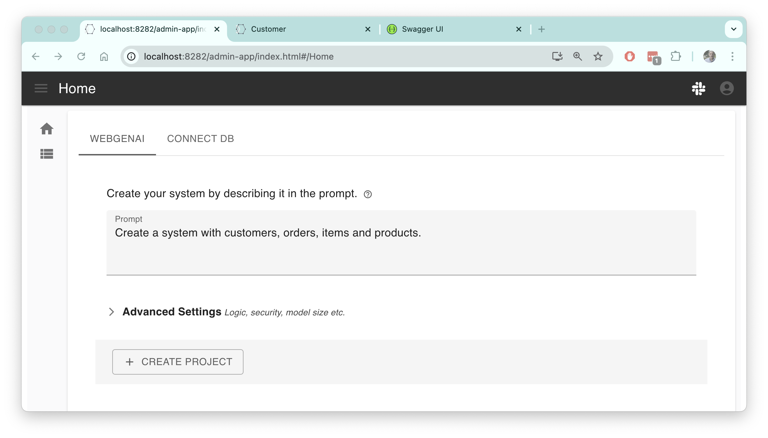



Idea
Running
Database
API
App
API
Logic

Slide 15
Kickstart: GenAI
- Idea to Run: 1 Minute
- Zero Training
- DB, API, Default App
App Model Editor
- Types, Masks, ??
Templates
- Card, Tree…
- Extensible
Solid API/Logic Server Architecture
Solid Requirements
UX
No ceiling
Standard Onimize components

